Slide 1
Lecture 4a – Clustering Mixed Data Types
Breitzman 7/15/2018

Slide 2
Beyond Cosine Similarity…
Last week we talked about clustering data and similarity matrices
The movie data we’ve been using has multiple variables but they are all the same type, lending themselves to vector similarity measures like the cosine measure
Often you will have variables of different types, so your world will be a little more complicated
Clustering will still work as discussed, but computing a similarity matrix will be more complicated

Slide 3
Data Types and Similarity Strategies
Term data, Frequency Data, Vector Data
  E.g. Movies, Terms in a document, Products bought at amazon, etc.
  Use Cosine Similarity
Asymmetric Binary Data – Data with 2 values, but positive value is of high importance, negative is ignored
  E.g. Has fever, has Diabetes, tested positive for something
  Use Jaccard
Symmetric Binary Data – Data with 2 values both of equal importance
  E.g M/F, Smoker/non-Smoker, Like/Didn’t Like
Categorical (Nominal) Data – Data that can take on multiple states but values have no meaningful order
  E.g. Red, Yellow, Blue, Green; Code X, Code Y, Code Z;
  Distance: match=1, non-match=0
Ordinal Data – Attributes that have a meaningful order
  Poor, Fair, Good, Excellent; Freezing, Cold, Mild, Warm, Hot
  Normalize then Euclidean distance
Numeric or Continuous Data – Regular data like 10, 20, 30, etc.
  Normalize then Euclidean

Slide 4
Frequency Data
We’ve dealt with frequency data with the movie database
Cosine similarity is the best all around similarity measure for this kind of data
It can be weighted with IDF and can be used with tens of thousands of dimensions
Works best with numbers between 0 and N (Our movie example broke this rule but worked ok. In general it’s best to use positive numbers because we will be mixing similarity matrices for different data types that won’t contain negatives)

Slide 5
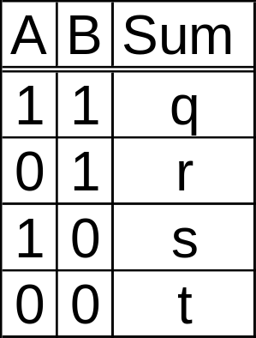
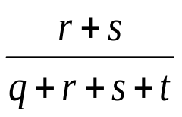
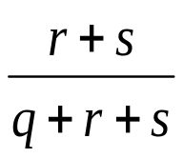
Binary Data
Symmetric Binary Distance: d(A,B)=
Asymmetric Binary Distance: d(A,B)=
Note in the latter, negative matches (t) are considered unimportant
Note Sim(A,B)=1-d(A,B)

Slide 6
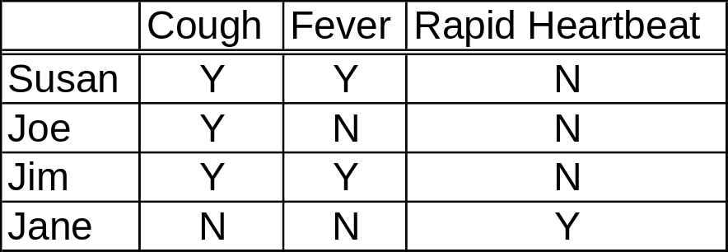
Asymmetric Binary Data Example
D(Susan,Joe)=1/2; Sim(Susan,Joe)=1/2
D(Susan,Jim)=0; Sim(Susan,Joe)=1
D(Susan,Jane)=(2+1)/3=1 Sim(Susan,Jane)=0
This distance measure is widely known as the jaccard distance
It can be used for term frequencies as well, but cosine is a bit easier to implement weighting factors like IDF

Slide 7
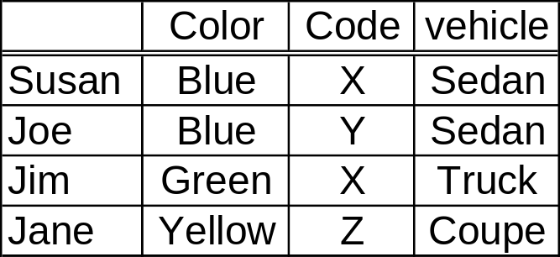
Categorical Data Example
Similarity=Matches/Variables
Sim(Susan,Susan)=3/3=1; D(Susan,Susan)=0
Sim(Susan,Joe)=2/3; D(Susan,Joe)=1/3
Sim(Susan,Jim)=1/3; D(Susan,Jim)=2/3
Sim(Susan,Jane)=0; D(Susan,Jane)=1

Slide 8
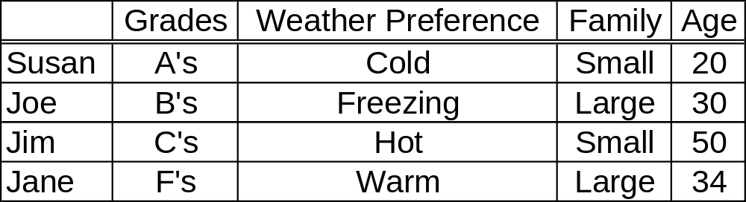
Ordinal and Numerical Data Example
Convert Ordinal Data to [0,1] by (Rank-1)/(Max-1)
For example Max Rank=A=5,Rank(F)=1
F=0, D=.25, C=.5, B=.75, A=1
Freezing=0, Cold=.33, Warm=.66, Hot=1
Small=0, Large=1
For age use min-max normalization (x-min)/(max-min)
20→0, 30→(30-20)/(50-20)=1/3, 50→1, 34→14/30=7/15

Slide 9
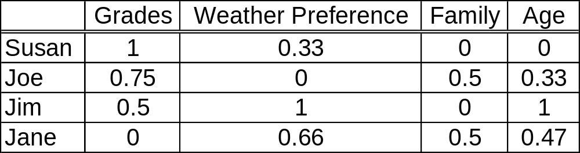
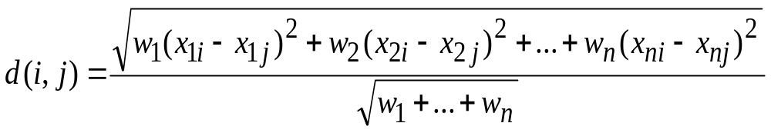
Transformed Table
Normalized Weighted Euclidean Distance
Regular Euclidean Distance is the same except we let each w=1
It should be clear that distance=0 for identical items and 1 for complete opposites (provided the data is transformed to be in [0,1])
Note weights can be added to the other distance measures as well

Slide 10
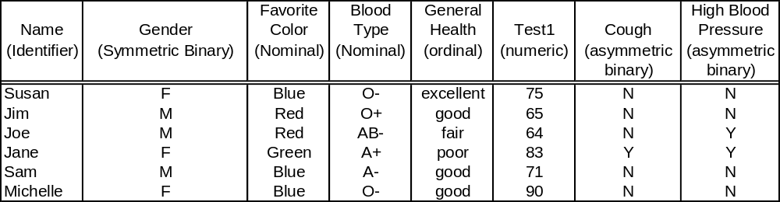
What do we do with mixed data?
Normalize the data and Compute Similarity Matrices for each type (5 types in this case)
Each Matrix is the Same Dimension (6x6 in this case)
Add Each Matrix together (first make them all similarity or dis-similarity matrices if they are not all the same type)
Divide each entry by 6 so that final similarities (or dis-similarities are between 0 and 1)
Actually if we want to weight each variable equally multiply the Nominal and Asymmetric matrices by 2 before adding and then divide by 7
Matrix should be symmetric with diagonals = 1 for similarity or 0 for dis-similarity
Now we see why it is best to have our clustering algorithm not recalculate the similarity matrix multiple times

Slide 11
Back to Movies
Knowing what we know now, how might we change the movie database so that it uses numbers between 0 and 1 in its similarity measures?
Ours didn’t have any negatives, but it’s theoretically possible to get negative similarities.
One easy fix would be to set any negative similarity to 0.
Another fix might be to change the rating to Didn’t See, Poor, Fair, Good, Great. In this case we could normalize each entry to Poor=0, Fair=.33, Good=.66, Great=1. Then set each weight to be 1 if both saw, and 0 otherwise. Weighted Euclidean would give us a dissimilarity matrix.
Let’s go to R and see if we get results similar to last week (Movies2.r)

